Slide 1

Week 8 Immigration: Living with cultural others

Slide 2
Learning objectives
At the end of this lecture, you should be able to:
Define culture shock and acculturation orientations.
Explain identity reconstruction and negotiation of immigrants.
Identify factors that facilitate the development of intercultural relations with cultural others.

Slide 3
Questions for you to think about
What influences immigrants’ opportunities in their new country?
What are some impacts of immigration on communities, families, children, and institutions of receiving countries?
How do immigrants locate a sense of identity, belonging, and home in their host country?

Slide 4
Experiences of entering a new culture
“We loved living in Mexico, but ultimately tired of being outsiders. The downside of a culture rooted in family clans is that friends aren’t as integral. Anna’s classmates rarely invited her home to play because there they played with their cousins. We had genuinely warm, but stubbornly superficial relationships with our neighbors. While it was possible for us to feel gloriously swept away by the splendor of Saint’s day celebrations, these holidays would never belong to us. And because most of the expatriates we met were either college students or retirees, we didn’t fit in with the foreigners either …”
-- Gina Hyams

Slide 5
Stages of culture shock
The initial stage: the honeymoon stage.
The second stage: disintegration of familiar cues and hostility with the differences experienced in the new culture.
The third stage: reintegration of new cues and an increased ability to function in the new culture.
The fourth stage: the adaptation stage.
The final stage: reciprocal interdependence where the person has achieved biculturalism.

Slide 6
Reverse culture shock
But we’ve been home five months now, and I’m not sure we belong in California anymore, either. We’re struggling to reconcile the Mexican sky that now fills our hearts with the daily grind of a more or less upwardly mobile life. I find myself wilfully spacing out, trying to slow down the pace, trying to hold onto the sense that time is simply time, not money. Perhaps we’ve become permanent expatriates – forever lost no matter our location.
-- Gina Hyams

Slide 7
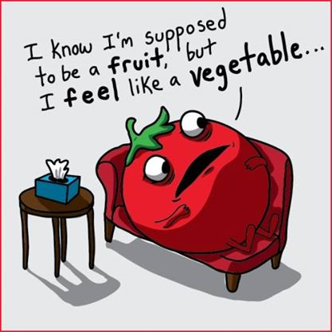
Acculturation
Acculturation is often marked by physical and psychological changes that occur as a result of the adaptation required to function in a new cultural context. The stress associated with such changes is called acculturative stress.

Slide 8
Four acculturation orientations
Maintain home culture
Yes
No
Yes
Integration | Assimilation
Separation | Marginalization
Maintain relationship
with mainstream culture
No
See the required reading by John Berry.

Slide 9
Identity negotiation for immigrants
Cultural transitions necessitate the reconstruction of identity.
Central to the culture-switching process is the presentation of the self in terms of their relationships to the ingroup (their ethnic group) and outgroup (the mainstream cultural group).
Connectedness to either their own ethnic group or the larger cultural group entails the presentation of self in different contexts.

Slide 10
Shifters and blenders
Shifters alternate behaviours to fit in the cultural context at a particular point in time, similar to code-switching.
Blenders do not compartmentalise elements of culture; they incorporate two or more cultures into a hybrid identity.

Slide 11
Factors influencing intercultural relations with immigrants
Similarity between the host and home cultures
Personal characteristics and background
Intergroup contact
Social support
The media
Political and social environment

Slide 12
Debates over cultural diversity
Significant debate has surrounded the question of how immigrants should live in their host societies. In some countries, immigrants are increasingly seen as a source of social disturbance and economic burden, and opinion polls show unease with the growing visibility of foreign cultures.

Slide 13
Is multiculturalism a benefit or a threat?
Some people argue that multiculturalism appeals more to low status groups than to high status groups due to differing benefits to low and high status groups – Ideological asymmetry hypothesis (Sidanius and Pratto, 1999).
Can you think of an example to illustrate the ideological asymmetry hypothesis?
Sidanius, J., & Pratto, F. (1999). Social dominance: An intergroup theory of social hierarchy and oppression. Cambridge: Cambridge University Press.

Slide 14
Questions for you to think about…
Will diversity arouse new forms of ethnic and religious isolation or will diversity lead to a genuine pluralism, a positive and interactive interpretation of plurality?

Slide 15
Next week…
In week 9, we will discuss diversity in workplaces.

